Slide 1


Project Review-2
on
Gesture Based Virtual Reality Systems
by Shyam S (1041210549, Y4) Mohammed Sadique (1041210566, Y4)
Geetha R (1041210579, Y4)
Under the guidance of
Mr. M.Maria Dominic Savio
Assistant Professor (O.G), Department of ECE
Department of ECE

Slide 2
Software Design Plan
Softwares used are Tridef, SweetFX,Arduino programming interface.
Tridef is a indie developed graphics injector. Injectors are softwares that highjack GPU pipe lines make necessary modification to the video data and sends it back to the pipe line.This software is used to simulate a Side by Side 3D output.

Slide 3
Software Design Plan-2
SweetFx is a set of libraries that were designed by open source Modding communities to improve textures and filters of a program. We are using this to create the vignette effect to account for lens distortion. Originally used by modders to create scope like effect for applications , we are using it for different purpose .
Arduino programming interface is used to code Arduino for control applications.

Slide 4
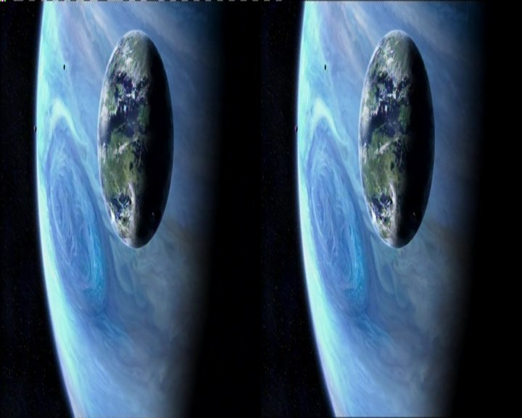
Software Design Plan-3
The dragon Board must also be programmed and kernel level changes must be made to force android to accepts inputs of gyroscope via low speed expansion I2C ports.
For Tech Demo we are planning to use Google earth , Mirrors edge ,Lumion .

Slide 5
Progress PC-Platform
In windows Platform we have made progress on Gesture , we have done user hand tracking using GY-521 and Arduino Leonardo.
We have processed the video feed of DirectX programs to account for chromic abbreviation, Lens distortion and issues like field of view is addressed.

Slide 6
Design
The connections are first made as shown in below picture , Then use DMP MPU6050 calibration sketch available in Arduino libraries to calculate the offset.
Please note that this offset differs widely with each chip of gy-521 is made and this method is a must for calibration.
Now a serial reader of GY-521 from Arduino libraries is used from the input X axis and Y axis is initialized to a variable. Using IF conditional statements keyboard commands is executed.

Slide 7
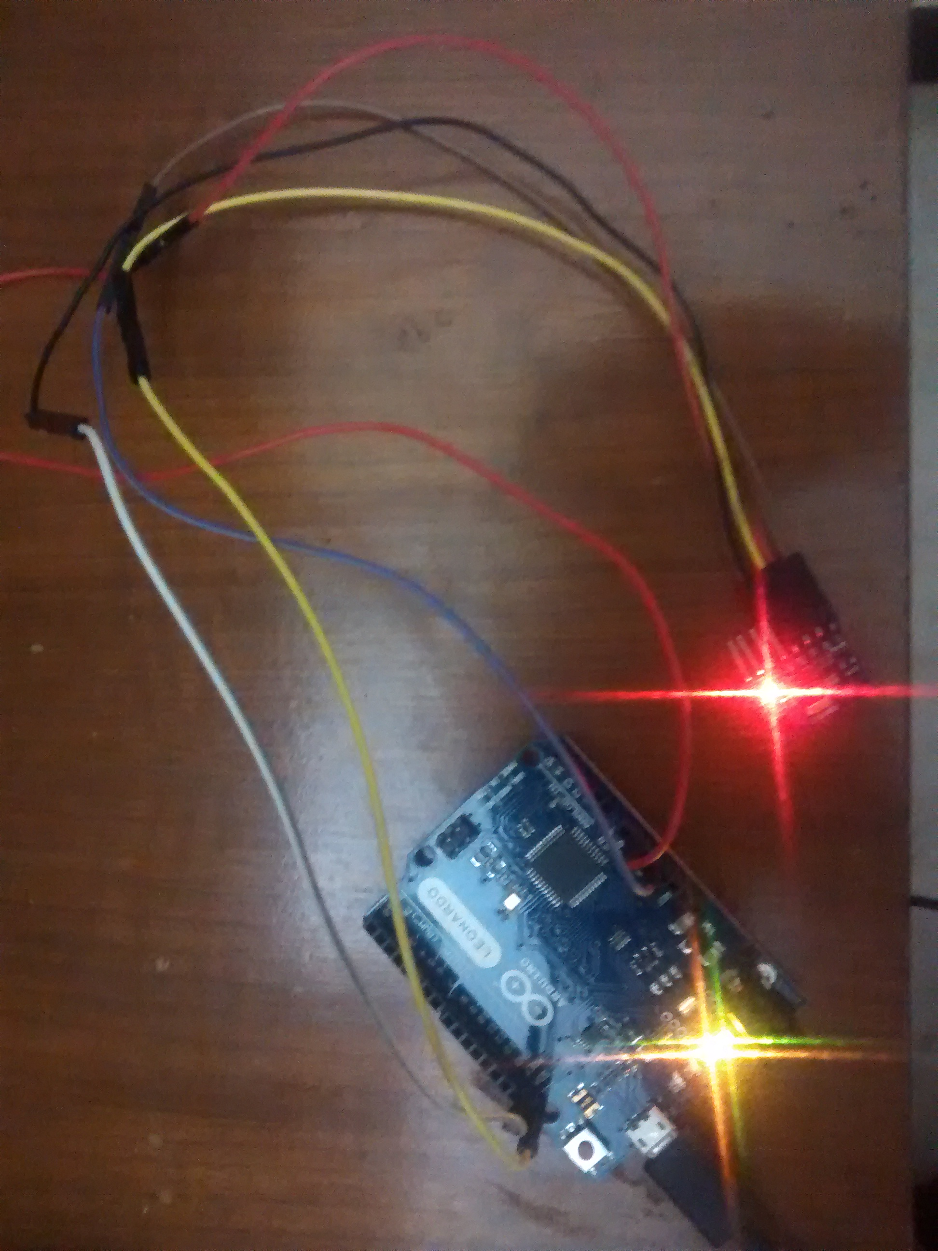
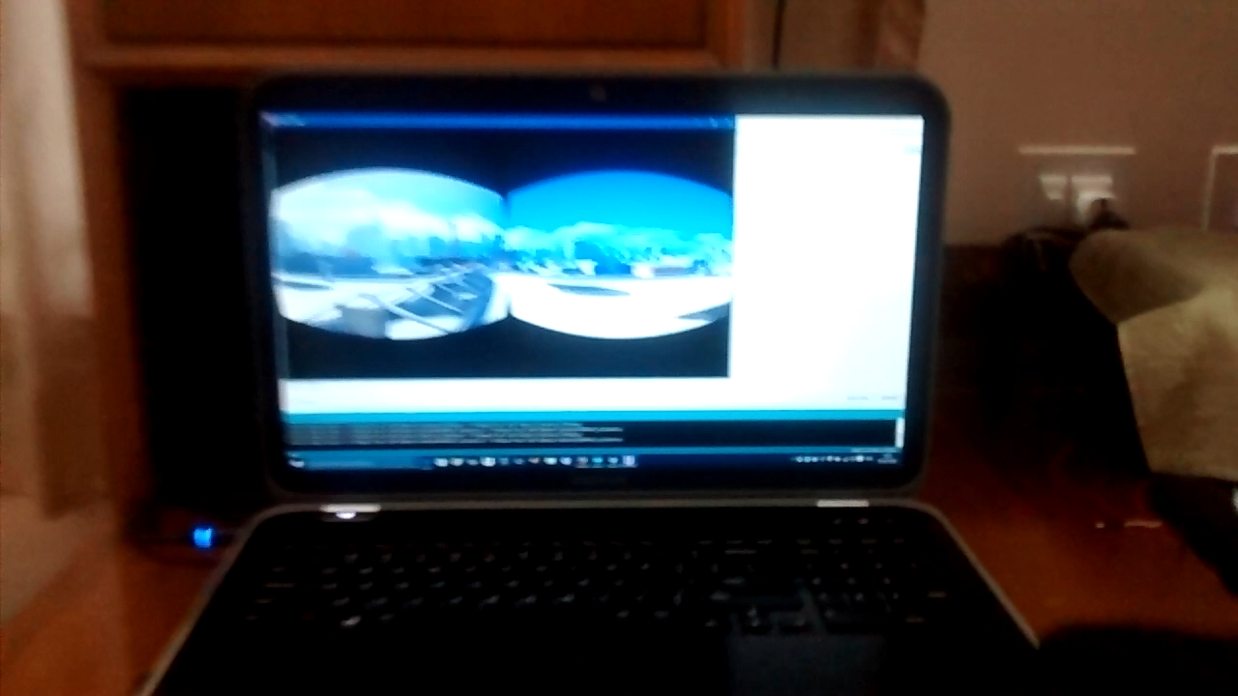
Picture and video of Hand Tracking

Slide 8
Image processing for HMD
First the DirectX program is injected with Program called Tridef 3D.This output absorbed from GPU pipeline is used to create a slightly altered view of the image in such a way it appears the camera is focusing on the object in slightly different angle. This image is used to create the SBS format.
Now this feed must be processed in such a way its quality is not altered by aspherical bifocal lens.
For This a program called sweetFX is used , Here 2 codes are adopted from open source community of sweetFX , They are chromic abbreviation and Vignette or famously know in oculus terms as barrel Distortion.

Slide 9
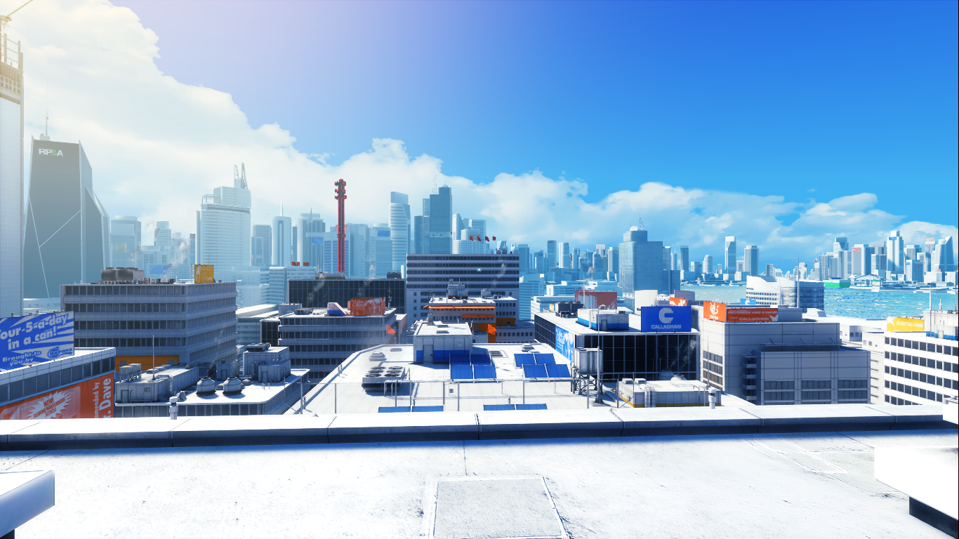
Output
Normal

Slide 10
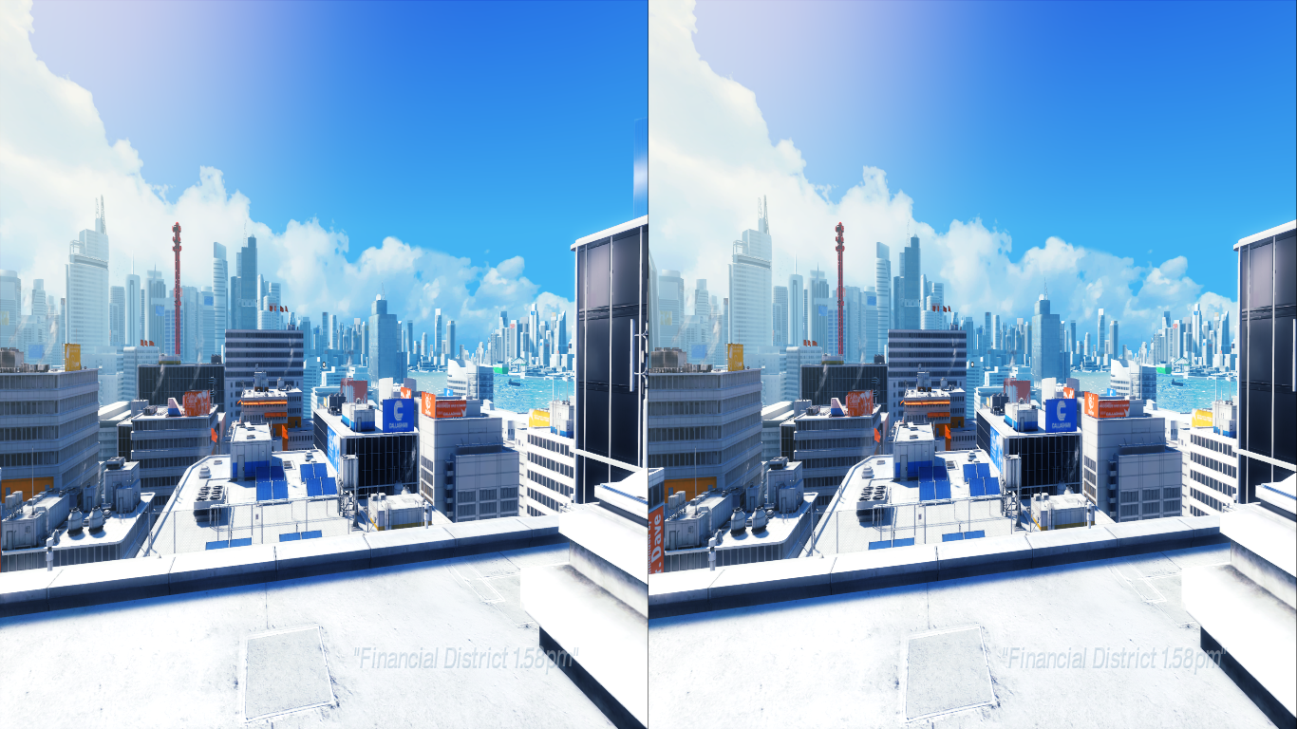
Tridef

Slide 11
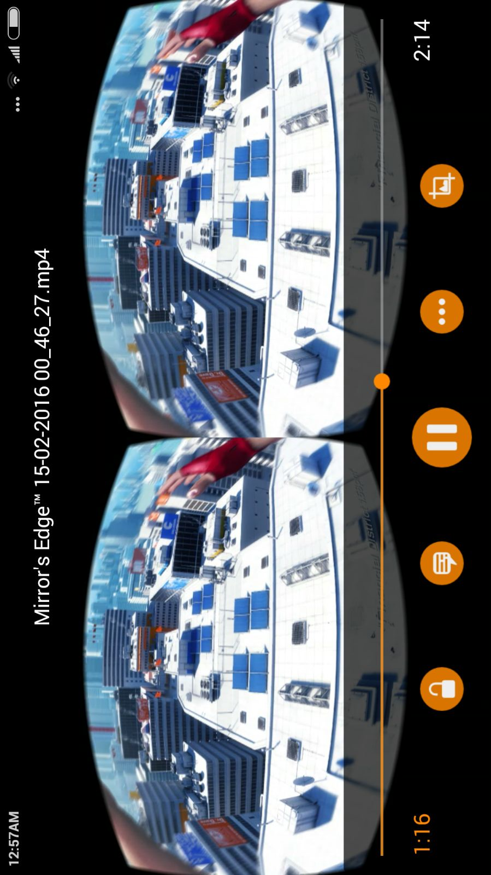
sweetfx

Slide 12
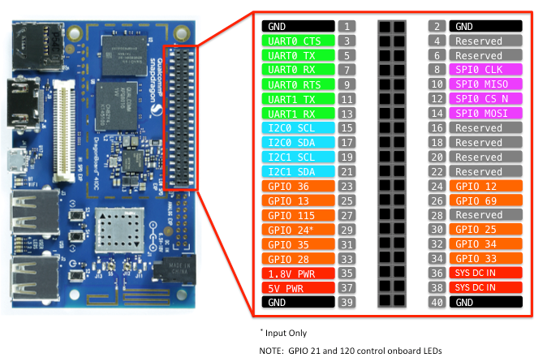
Android platform.
Head tracking is successfully implemented using DragonBoard 410C and android VR app is successfully run.
To integrate the GY-521 with dragonboard kernel level changes is needed.

Slide 13
1. Change the directory to the source root
cd$BUILDROOT source build/envsetup.sh
lunch msm8916_64-userdebug
2. To launch the kernel configuration and run the command
Make -j8 kernelconfig Where -j8 depends on the Linux machine cores; change accordingly.
In the configuration window we have to select Linux/arm64 3.10.49 kernel configuration. Then the following steps has to be done.
• Menu → Select Device Drivers → Industrial I/O support → Gyro521 → MPU 6050
• Build kernel configuration as gyroscope to detect head motion.
• Save and exit from the kernel config menu.

Slide 14
If we are adding a new driver on our own we need to make changes to Makefile and Kconfig to find the new entries in the kernel config screen, driver files need to be added in the same directory as well.
• Then Open kernel/arch/arm64/boot/dts/qcom/apq8016-sbc.dtsi and add the code as follows.
mpu6050
{
compatible = "taos, mpu6050";
reg = <0x29>;
};
• Save the file and then run the command:
Make -j8 bootimage
boot.img will be generated at out/target/product/msm8916_64/boot.img.
• Now the kernel configuration done with required modifications.

Slide 15


